Slide 1
Artificial Intelligence
Genetic Algorithm
ADF

Slide 2
Outline
Metaheuristic Search
Evolutionary Algorithms
Genetic Algorithm
Chromosome
Fitness
Parent Selection
Crossover and Mutation
Survivor Selection

Slide 3
Metaheuristic Search
A higher-level procedure or heuristic designed to find, generate, or select a heuristic (partial search algorithm) that may provide a sufficiently good solution to an optimization problem,
especially with incomplete or imperfect information or limited computation capacity
Sample a set of solutions which is too large to be completely sampled

Slide 4
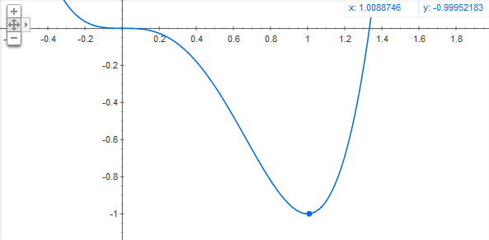
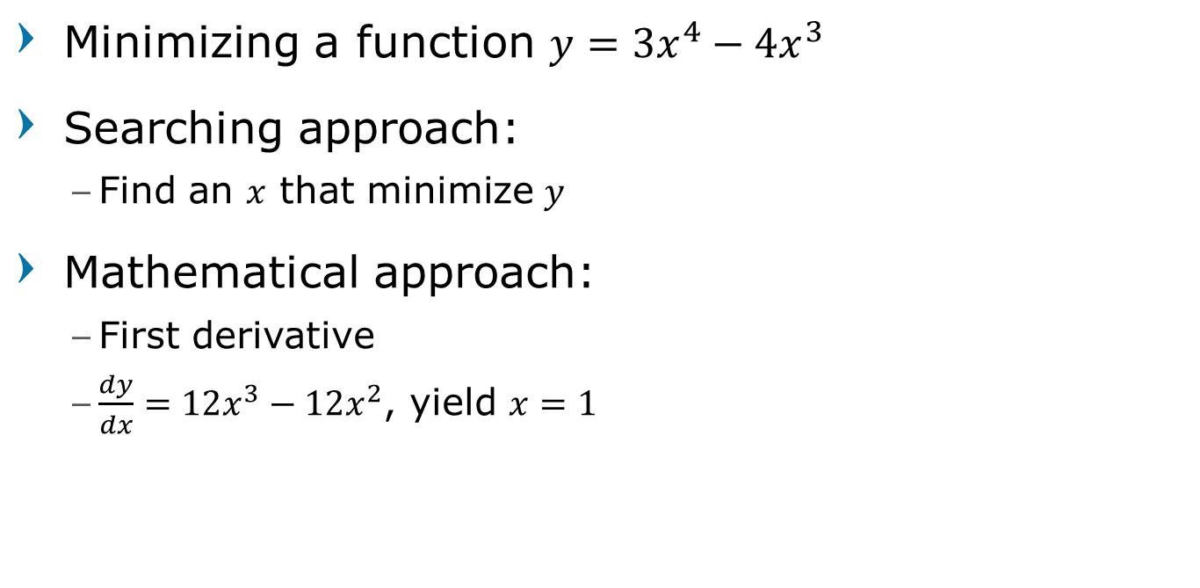
Mathematical optimization
Minimizing a function $y={3x}^{4}−4x^{3}$
Searching approach:
Find an $x$ that minimize $y$
Mathematical approach:
First derivative
$\frac{dy}{dx}=12x^{3}−12x^{2}$, yield $x=1$

Slide 5
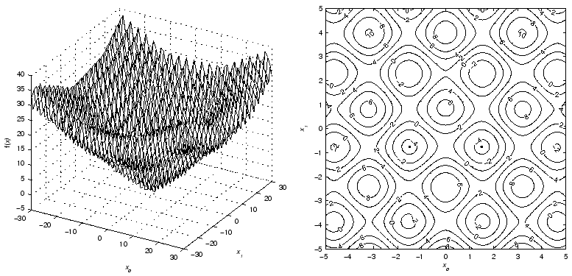

Mathematical optimization
$$f\left(\vec{x}\right)=\sum_{i=0}^{D−1}{\left(e^{−0.2}\sqrt{x_{i}^{2}+x_{i+1}^{2}}+3\left(\cos\left(2x_{i}\right)+\sin\left(2x_{i+1}\right)\right)\right)}$$
First derivative?
Really Difficult

Slide 6
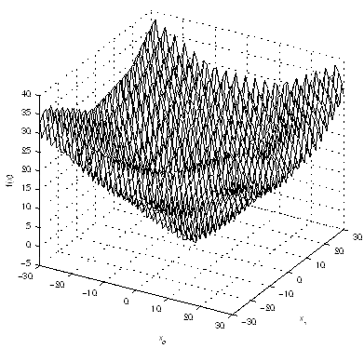
Random Search

Slide 7
Simulated Annealing

Slide 8
Genetic Algorithm
Generation=1

Slide 9
Genetic Algorithm
Generation=2

Slide 10
Genetic Algorithm
Generation=5

Slide 11
Genetic Algorithm
Generation=10

Slide 12
Time to Complete
Example: TSP 100 locations, 8 hours work day
 | Manual thinking
Running time (algorithm) | 0
Time to complete the route resulted | 11 hours
Total time spent | 11 hours
Software A (Dijkstra)
2 hours
7 hours
9 hours
Software B (Genetic Algorithm)
10 minutes
7 hours and 20 minutes
7.5 hours
overtime | 3 hours
1 hours
-

Slide 13
Optimization Algorithm

Slide 14
Evolutionary Computation
an abstraction from the theory of biological evolution that is used to create optimization procedures or methodologies,
usually implemented on computers, that are used to solve problems

Slide 15
Evolutionary Algorithms
generic, population-based meta-heuristic optimization algorithms that use biology-inspired mechanisms like mutation, crossover, natural selection and survival of the ﬁttest.
EAs are algorithms which implement the EC abstractions

Slide 16
Evolutionary Algorithms
Genetic Algorithms (GA): binary strings
Evolution Strategies (ES): real-valued vectors
Evolutionary Programming (EP): finite state machines
Genetic Programming (GP): LISP trees
Differential Evolution (DE)
Grammatical Evolution (GE)

Slide 17
EAs General Scheme
Parent Selection
Parents
initiate
Recombination
Population
Mutation
terminate
Offspring
Survivor Selection

Slide 18
EC Applications: Optimization
Scheduling
Course scheduling, company/project time table, hospital scheduling, etc.
Knapsack Problem, Packaging,
Cutting Stock Problem
Design Simulation
Etc.

Slide 19


Jet Nozzle Design
Starting
Resulting

Slide 20
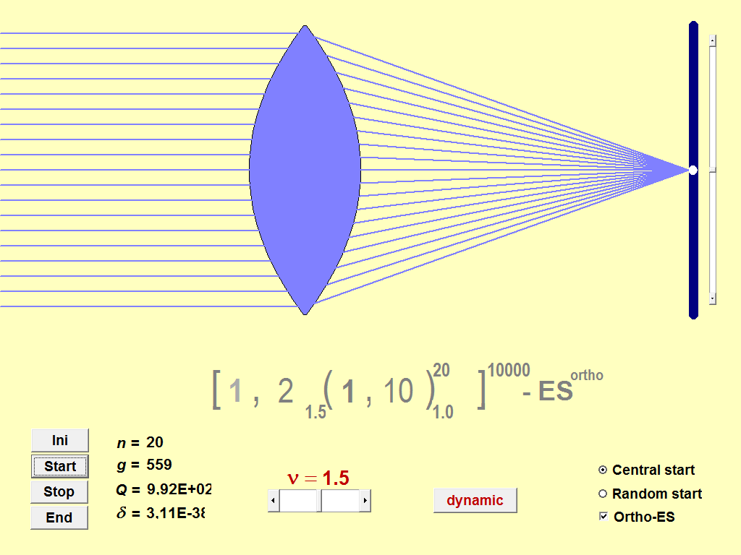
Optic Lenses Design

Slide 21
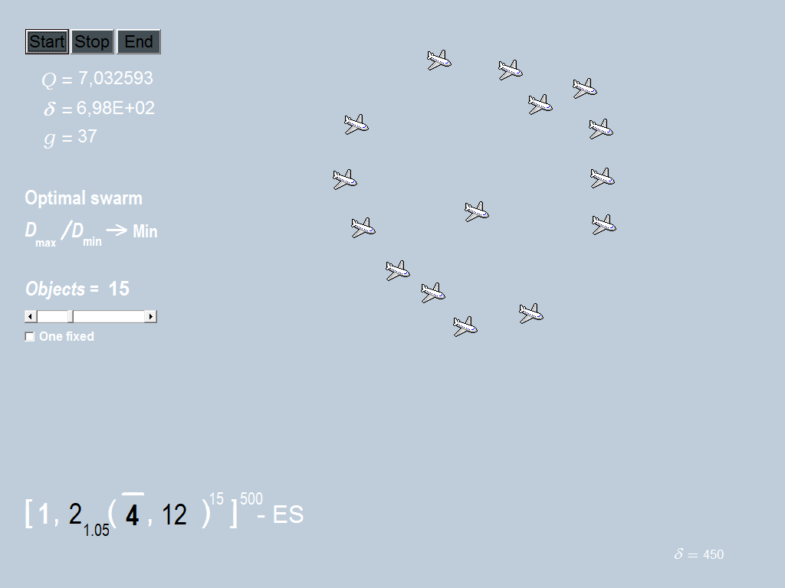
Swarm Intelligence

Slide 22
Genetic Algorithms
a particular class of evolutionary algorithms that use techniques inspired by evolutionary biology such as inheritance, mutation, selection, and crossover
Originally developed by John Holland (1975)

Slide 23
Properties of Genetic Algorithms
Individual - Any possible solution
Population - Group of all individuals
Search Space - All possible solutions to the problem
Chromosome - Blueprint for an individual
Fitness – quality of a solution
Recombination - decomposes two distinct solutions and then randomly mixes their parts to form novel solutions
Mutation - randomly perturbs a candidate solution

Slide 24
Genetic Algorithms
generation = maxGeneration ?
bestFitness > threshold ?
Initiate Random Population
Fitness Evaluation
START
STOP
yes
no
generation=1
Survivor Selection
Parent Selection
Mutation
Crossover

Slide 25
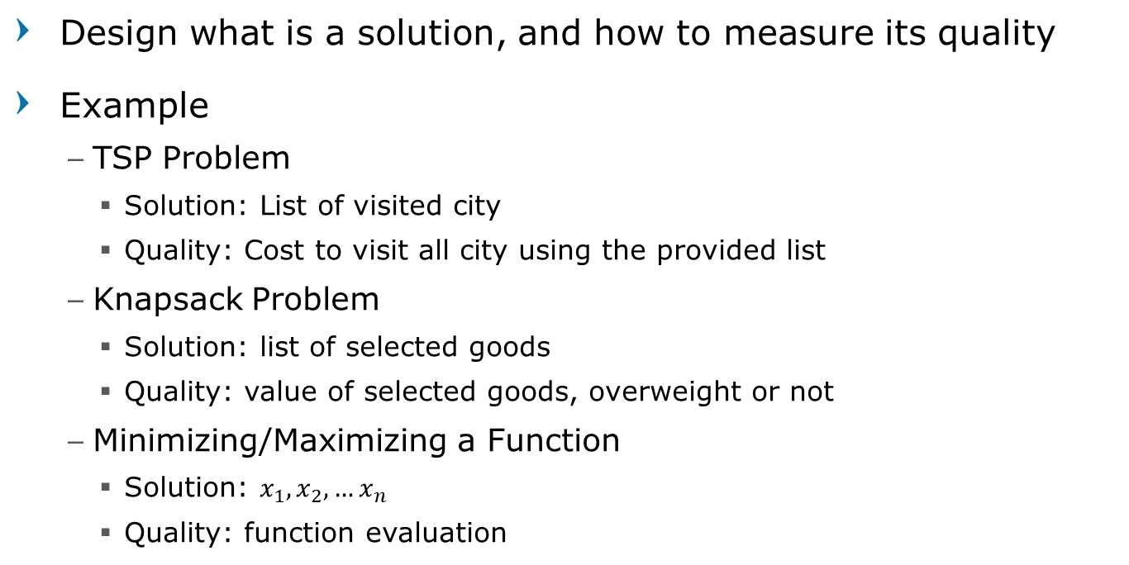
Representing Solution
Design what is a solution, and how to measure its quality
Example
TSP Problem
Solution: List of visited city
Quality: Cost to visit all city using the provided list
Knapsack Problem
Solution: list of selected goods
Quality: value of selected goods, overweight or not
Minimizing/Maximizing a Function
Solution: $x_{1}, x_{2}, …x_{n}$
Quality: function evaluation

Slide 26
Chromosome
Blueprint (a set of parameters) which define a proposed solution to the problem
Represented in a string
Traditionally as binary, but other encodings such as integer or real are also possible
The evolution usually starts from a population of randomly generated individuals

Slide 27
Chromosome

Slide 28
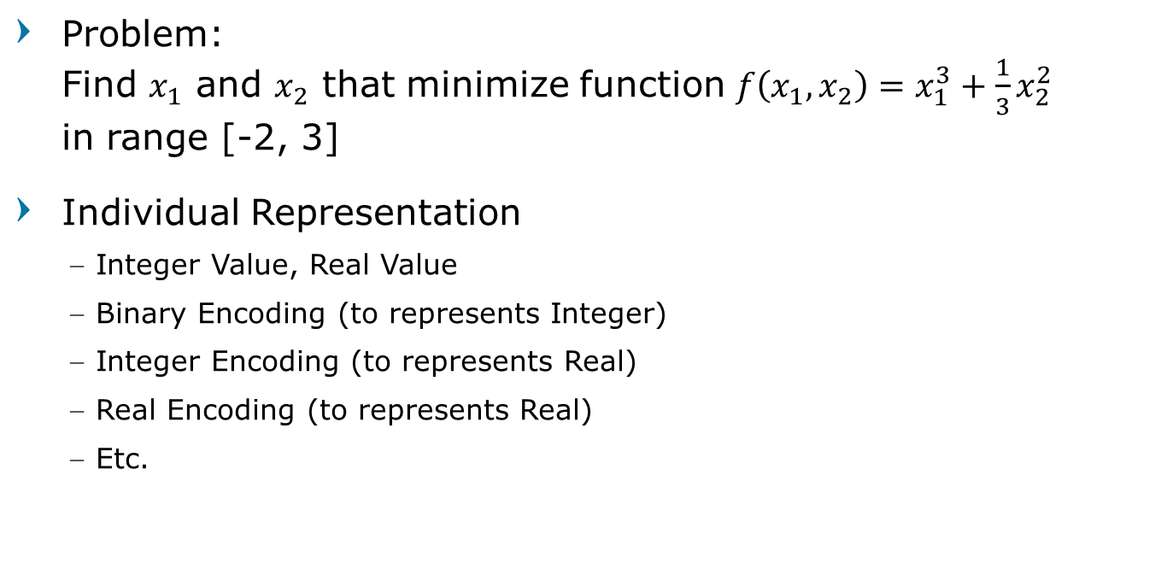
Chromosome Example
Problem: Find $x_{1}$ and $x_{2}$ that minimize function $f\left(x_{1},x_{2}\right)=x_{1}^{3}+\frac{1}{3}x_{2}^{2}$ in range [-2, 3]
Individual Representation
Integer Value, Real Value
Binary Encoding (to represents Integer)
Integer Encoding (to represents Real)
Real Encoding (to represents Real)
Etc.

Slide 29
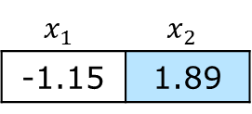
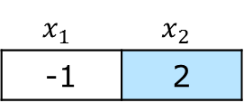


Chromosome Example
Genotype | Phenotype
Integer Value
$$x_{1}$$ | $$x_{2}$$
-1 | 2
$x_{1}=−1$
$x_{2}=2$
Real Value
$$x_{1}$$ | $$x_{2}$$
-1.15 | 1.89
$x_{1}=−1.15$
$x_{2}=1.89$

Slide 30

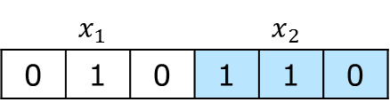


Chromosome Example
Genotype | Phenotype
Binary Encoding using 3 bits (3 gens)
$$x_{1}$$ |  |  | $$x_{2}$$
0 | 1 | 0 | 1 | 1 | 0
$$x=r_{min}+\frac{r_{max}−r_{min}}{Σ_{i=1}^{N}2^{−i}}\left(g_{1}∗2^{−1}+g_{1}∗2^{−2}+…+g_{N}∗2^{−N}\right)$$
$x_{1}=−0.57$
$x_{2}=2.29$
$$x_{1}=−2+\frac{3−\left(−2\right)}{(2^{−1}+2^{−2}+2^{−3})}\left(0∗2^{−1}+1∗2^{−2}+0∗2^{−3}\right)$$
$$x_{2}=−2+\frac{3−\left(−2\right)}{(2^{−1}+2^{−2}+2^{−3})}\left(1∗2^{−1}+1∗2^{−2}+0∗2^{−3}\right)$$

Slide 31
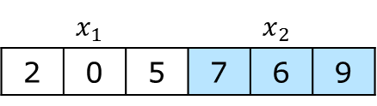

Chromosome Example
Genotype | Phenotype
Integer Encoding using 3 gens
$$x_{1}$$ |  |  | $$x_{2}$$
2 | 0 | 5 | 7 | 6 | 9
$$x=r_{min}+\frac{r_{max}−r_{min}}{Σ_{i=1}^{N}9∗{10}^{−i}}\left(g_{1}∗{10}^{−1}+g_{1}∗{10}^{−2}+…+g_{N}∗{10}^{−N}\right)$$
$x_{1}=−0.97$
$x_{2}=1.84$
$$x_{1}=−2+\frac{3−\left(−2\right)}{9∗({10}^{−1}+{10}^{−2}+{10}^{−3})}\left(2∗{10}^{−1}+0∗{10}^{−2}+5∗{10}^{−3}\right)$$
$$x_{2}=−2+\frac{3−\left(−2\right)}{9∗({10}^{−1}+{10}^{−2}+{10}^{−3})}\left(7∗{10}^{−1}+6∗{10}^{−2}+9∗{10}^{−3}\right)$$

Slide 32

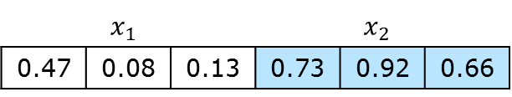



Chromosome Example
Genotype | Phenotype
Real Encoding using 3 gens
$$x_{1}$$ |  |  | $$x_{2}$$
0.47 | 0.08 | 0.13 | 0.73 | 0.92 | 0.66
$$x=r_{min}+\frac{r_{max}−r_{min}}{N}\left(g_{1}+g_{1}+…+g_{N}\right)$$
$x_{1}=−0.87$
$x_{2}=1.85$
$$x_{1}=−2+\frac{3−\left(−2\right)}{3}\left(0.47+0.08+0.13\right)$$
$$x_{2}=−2+\frac{3−\left(−2\right)}{3}\left(0.73+0.92+0.66\right)$$

Slide 33
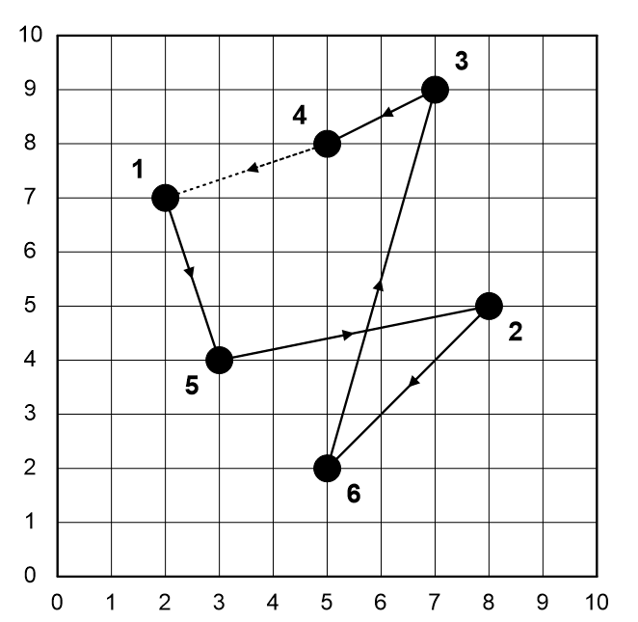
Chromosome Example
Traveling Salesman Problem
Individual Representation
Ordered chromosome
Permutation
→ order of visit →
1 | 5 | 2 | 6 | 3 | 4
city number to visit

Slide 34
Objective Function
Evaluation of a chromosome
Values/properties of a solution represented by a chromosome
A solution may have multiple objective functions designed
Should consider all the existing constraints

Slide 35
Fitness Function
Quality of a chromosome
A value to indicate the quality of a solution
Survival of the fittest
The higher the fitness means the better the solution
Higher fitness should survive
Low fitness individual will perish

Slide 36
Fitness Function
Characteristic
Clearly defined (from the objective function)
Should be sufficiently fast to compute
Should generate intuitive results.
The best/worst candidates should have best/worst score values

Slide 37






Fitness Function
Maximizing the objective function
Minimizing the objective function
Or its combination
$$f=h$$
$$f=h_{1}+h_{2}+…h_{n}$$
$$f=\frac{1}{h+a}$$
$$f=\frac{1}{h_{1}+h_{2}+…+h_{n}+a}$$
$$f=−h$$
$f=\frac{1}{h_{1}+a}+\frac{1}{h_{2}+a}+…+\frac{1}{h_{n}+a}$

Slide 38
Parent Selection
Process to select individuals as parents to generate new offspring for the next generation
Individual solutions are selected through a fitness-based process
Popular and well-studied methods:
Roulette Wheel Selection
Tournament Selection
[New] Roulette Wheel via Stochastic Acceptance

Slide 39
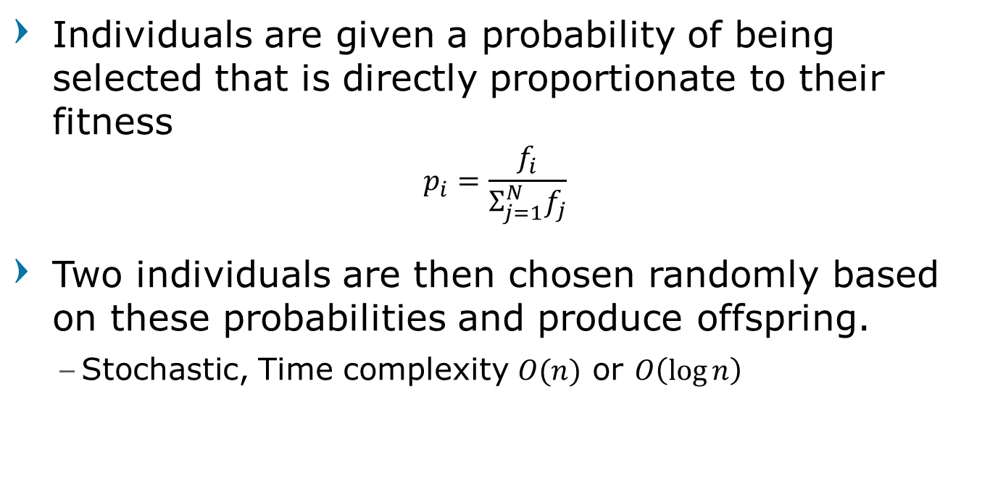
Roulette Wheel Selection
Individuals are given a probability of being selected that is directly proportionate to their fitness
$$p_{i}=\frac{f_{i}}{Σ_{j=1}^{N}f_{j}}$$
Two individuals are then chosen randomly based on these probabilities and produce offspring.
Stochastic, Time complexity $O(n)$ or $O\left(\log{n}\right)$

Slide 40
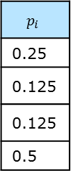
Roulette Wheel Selection
function RouletteWheelSelection (fitness)
total = 0
for indv = 1 to n do
total += fitness(indv)
r = random_uniform()
indv = 1
while( r > 0 ) do
r -= fitness(indv)/total
indv ++
return indv
Chromosome | Fitness
C1 | 2
C2 | 1
C3 | 1
C3 | 4
$$p_{i}$$
0.25
0.125
0.125
0.5
total | 8
Illustration 1
random= 0.32
Illustration 2

Slide 41
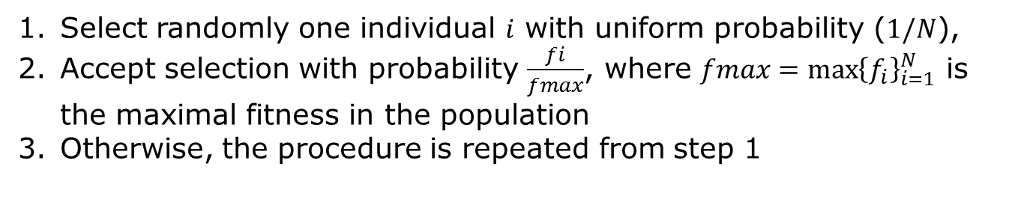



Stochastic Roulette Wheel Selection
Select randomly one individual $i$ with uniform probability ($1/N$),
Accept selection with probability $\frac{fi}{fmax}$, where $fmax={\max\left\{f_{i}\right\}}_{i=1}^{N}$ is the maximal fitness in the population
Otherwise, the procedure is repeated from step 1
function StochasticRouletteWheel(fitness)
maxFitness = max(fitness)
while(true)
indv = random_uniform()*N
r = random_uniform()
if( r < fitness(indv)/maxFitness )
return indv
Chromosome | Fitness
C1 | 2
C2 | 1
C3 | 1
C3 | 4
Selection probability
$$\frac{2}{4}$$
$$\frac{1}{4}$$
$$\frac{1}{4}$$
$$\frac{4}{4}$$
Acceptance probability

Slide 42
Tournament Selection
less stochastic noise,
fast, easy to implement
have a constant selection pressure
choose k (the tournament size) individuals from the population at random
choose the best individual from pool/tournament with probability p
choose the second best individual with probability p*(1-p)
choose the third best individual with probability p*((1-p)²)
and so on...
function tournamentSelection(pop, k):
best = []
for i=1 to k
indv = pop[random(1, N)]
if (best == []) or fitness(indv) > fitness(best)
best = indv
return best

Slide 43
Crossover or Recombination
Enables the evolutionary process to move toward promising regions of the search space
Matches good parents’ sub-solutions to construct better offspring
Crossover does not always occur
based on a set probability
The probability of crossover is usually 60% to 70%.

Slide 44
Crossover or Recombination
General Schemes:
Single-Point, Two-Point, n-point crossover
Uniform crossover, Arithmetic crossover
etc.
For ordered chromosome
Partially matched crossover
Cycle crossover
Order crossover
etc.

Slide 45

Crossover or Recombination
Single-point - Randomly select a point
Two-points - Randomly select two points
Parent 1
1 | 0 | 1 | 1 | 0 | 1 | 0 | 1
1 | 0 | 1 | 0 | 1 | 1 | 1 | 0
offspring 1
Parent 2
0 | 1 | 1 | 0 | 1 | 1 | 1 | 0
0 | 1 | 1 | 1 | 0 | 1 | 0 | 1
offspring 2
Parent 1
1 | 0 | 1 | 1 | 0 | 1 | 0 | 1
1 | 0 | 1 | 0 | 1 | 1 | 0 | 1
offspring 1
Parent 2
0 | 1 | 1 | 0 | 1 | 1 | 1 | 0
0 | 1 | 1 | 1 | 0 | 1 | 1 | 0
offspring 2

Slide 46
Mutation
to simulate the effect of errors that happen with low probability during duplication
small chance of mutation
loop through all the alleles
By a small probability (~1%), either change it by a small amount or replace it with a new value
Initial chromosome
1 | 0 | 1 | 1 | 0 | 1 | 0 | 1
Mutation process
1 | 0 | 1 | 1 | 0 | 1 | 0 | 1
1
0
1
1
0
1
0
0
1
Result:
1 | 0 | 1 | 1 | 0 | 0 | 0 | 1

Slide 47
Mutation
General Schemes:
Bit-level mutation
Gene/allele-level mutation
Chromosome-level mutation
For ordered chromosome
Swap mutation
Scramble mutation
etc.

Slide 48
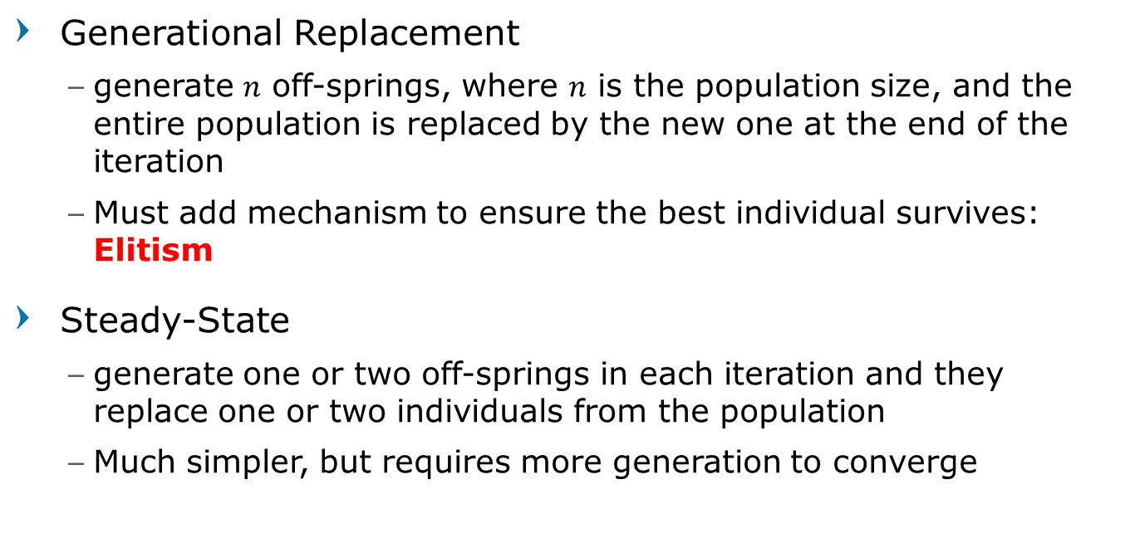
Survivor Selection
Generational Replacement
generate $n$ off-springs, where $n$ is the population size, and the entire population is replaced by the new one at the end of the iteration
Must add mechanism to ensure the best individual survives: Elitism
Steady-State
generate one or two off-springs in each iteration and they replace one or two individuals from the population
Much simpler, but requires more generation to converge

Slide 49
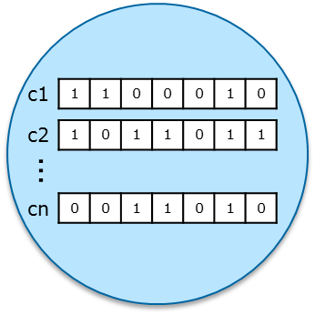
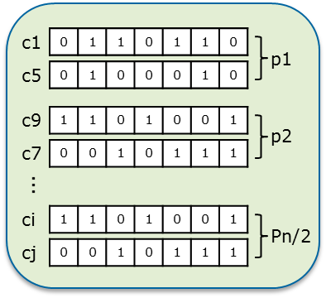
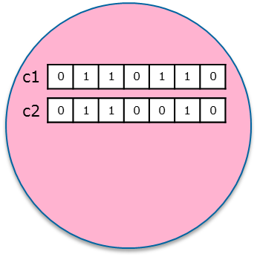
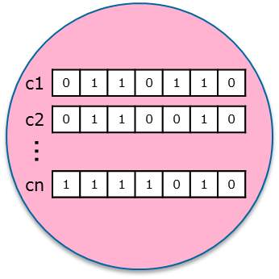
Generational Replacement
population = generatePopulation(N)
while stoppingCondition is not satisfied
fitness = evaluate(population)
newPopulation = elitism(population, fitness)
while size(pool) < N
parent1, parent2 = parentSelection(population)
offspring = crossover(parent1, parent2, pC)
offspring = mutate(offspring, pM)
newPopulation.add(offspring)
end
population = pool
end
initial generation
Mating pool
Replace
Elitism
Crossover
add
Mutation
next generation

Slide 50
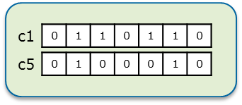
Steady-State
population = generatePopulation(N)
while stoppingCondition is not satisfied
fitness = evaluate(population)
parent1, parent2 = parentSelection(population)
offspring = crossover(parent1, parent2, pC)
offspring = mutate(offspring, pM)
population = steadyState(population, offspring)
end
initial generation
Parent selection
next generation
Crossover
Mutation
Steady-state selection
Replace

Slide 51
Elitism
Usually used in Generational Replacement type
Copied the best chromosomes into the next generation once or twice
Ensure the solution quality obtained will not decrease from one generation to the next

Slide 52
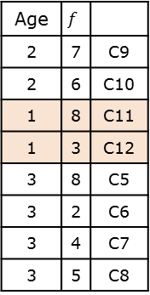
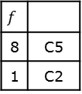
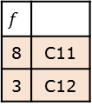
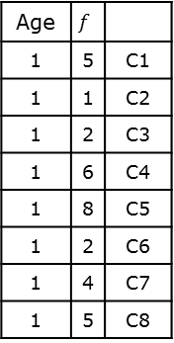
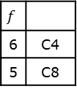
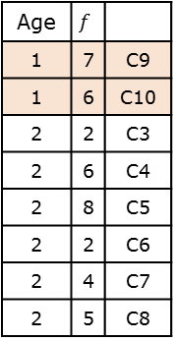
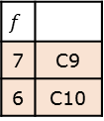
Steady-State procedures
Age-based selection
Offspring replaces the oldest individual in population
Age | $$f$$
1 | 5 | C1
1 | 1 | C2
1 | 2 | C3
1 | 6 | C4
1 | 8 | C5
1 | 2 | C6
1 | 4 | C7
1 | 5 | C8
Age | $$f$$
1 | 7 | C9
1 | 6 | C10
2 | 2 | C3
2 | 6 | C4
2 | 8 | C5
2 | 2 | C6
2 | 4 | C7
2 | 5 | C8
Age | $$f$$
2 | 7 | C9
2 | 6 | C10
1 | 8 | C11
1 | 3 | C12
3 | 8 | C5
3 | 2 | C6
3 | 4 | C7
3 | 5 | C8
parent selection
offspring
parent selection
offspring
$$f$$
8 | C5
1 | C2
$$f$$
7 | C9
6 | C10
$$f$$
6 | C4
5 | C8
$$f$$
8 | C11
3 | C12
generation 1
generation 2
generation 3

Slide 53
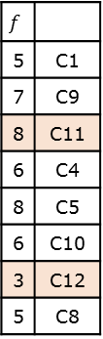
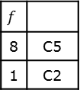
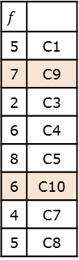
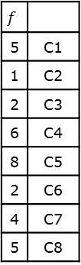
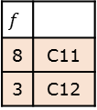

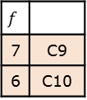
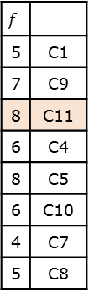
Steady-State procedures
Fitness-based selection
Offspring replaces individual with the worst fitness value in population
$$f$$
5 | C1
1 | C2
2 | C3
6 | C4
8 | C5
2 | C6
4 | C7
5 | C8
$$f$$
5 | C1
7 | C9
2 | C3
6 | C4
8 | C5
6 | C10
4 | C7
5 | C8
$$f$$
5 | C1
7 | C9
8 | C11
6 | C4
8 | C5
6 | C10
3 | C12
5 | C8
$$f$$
5 | C1
7 | C9
8 | C11
6 | C4
8 | C5
6 | C10
4 | C7
5 | C8
or using re-evaluate method
parent selection
offspring
parent selection
offspring
$$f$$
8 | C5
1 | C2
$$f$$
7 | C9
6 | C10
$$f$$
6 | C4
5 | C8
$$f$$
8 | C11
3 | C12
generation 1
generation 2
generation 3

Slide 54
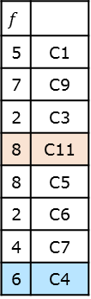
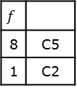
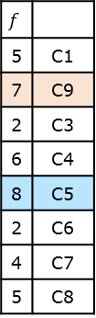
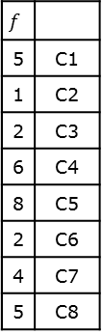
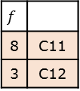
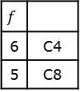



Steady-State procedures
Local Fitness-based selection
Select the best individuals form a pair of parents and its offspring to replace one or all the parents
$$f$$
5 | C1
1 | C2
2 | C3
6 | C4
8 | C5
2 | C6
4 | C7
5 | C8
$$f$$
5 | C1
7 | C9
2 | C3
6 | C4
8 | C5
2 | C6
4 | C7
5 | C8
$$f$$
5 | C1
7 | C9
2 | C3
8 | C11
8 | C5
2 | C6
4 | C7
6 | C4
parent selection
offspring
selected
parent selection
offspring
selected
$$f$$
8 | C5
1 | C2
$$f$$
7 | C9
6 | C10
$$f$$
8 | C5
7 | C9
$$f$$
6 | C4
5 | C8
$$f$$
8 | C11
3 | C12
$$f$$
8 | C11
6 | C4
generation 1
generation 2
generation 3

Slide 55
Stopping Criteria
Max iteration (max generation)
Time limit
Fitness plateau
Fitness threshold
Population and Generational diversity

Slide 56
EAs are suitable for problems:
Complex Problem
Difficult to understand
Can not use conventional methods
Real time system
The solution does not have to be the most optimal
No prior knowledge
No mathematical analysis is available

Slide 57

Choosing Searching Method
How big is the problem space?
What is the branching factor ($b$) and the depth of the solution ($d$)?
How much processor and memory space available?
Does the solution have to be optimal?
Can the heuristic function be found/formulated?
There is one goal or more?

Slide 58
Conclusion
The methods included in the blind search require enormous memory to solve simple problems.
With the current speed and limited computer memory, currently blind search is not yet possible to be implemented into the real world.
The only method that might be used is Iterative Deepening Search (IDS) as it requires very little memory even though the processing time is very long.

Slide 59
Conclusion
Among the search methods included in the heuristic search, A* is the best option when we can find a heuristic function for the problem to be solved.
We can choose the A* variation that best fits the problem to be solved and the resources (time and memory) we have.
When more than one type of heuristic function is found, choose the one closest to the actual cost.

